Slide 1
Mini Popper | Colt poppers | Pepper poppers | Plates | Wall feet
6 | 5 | 0 | 0 | 68
Bay | Stage | Target Type | Count | NS | Total | Hard Cover
A2 | Big Bertha | IPSC | 11 | 2 | 13 | 3 Tux
A1 | A Long Way | USPSA | 8 | 2 | 10 | 1 Tux
B1 | Cul-De-Sac | USPSA | 9 | 3 | 12 | 2 Tux 1 Left Diag 1 Right Diag
B2 | Tabletop | IPSC | 7 | 2 | 9 | 1 Tux 1 Left Diag 1 Right Diag
B3 | Handholding | IPSC | 7 | 2 | 9 | 1 Left Diag
B4 | 19-01 | USPSA | 6 | 2 | 8

Slide 2
Prop | Stage
Pull cord barricade | 5, bay B3
Swingers x2 | 4, B2
Stomp pad | 4, B2

Slide 3

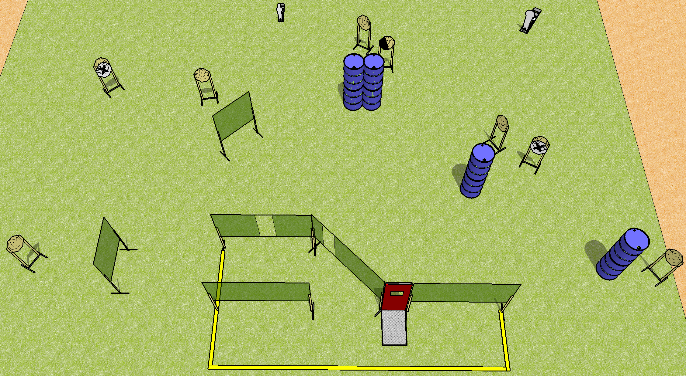
 | Dothan Practical Shooters – USPSA Match Handholding Course Designer : Drew Coleman Bay: B3
Round Count 18 rounds 8 IPSC 1 mini, 1 colt
Equipment List 12 wall feet Pull cord barricade 1 left diag 9 targets (7 + 2 NS)

Slide 4
Stage Name
Written Stage Briefing
Scoring: Comstock Rounds: 18
Targets: 8 IPSC, 2 steel
Handgun start position: anywhere inside the shooting area, wrists above shoulders. Handgun is loaded and holstered.
PCC start position: anywhere inside the shooting area, wrists above shoulders. Loaded carbine is held with both hands, safety on.
Stage Procedure: on the audible start signal, engage targets as they become available from within the shooting area.

Slide 5
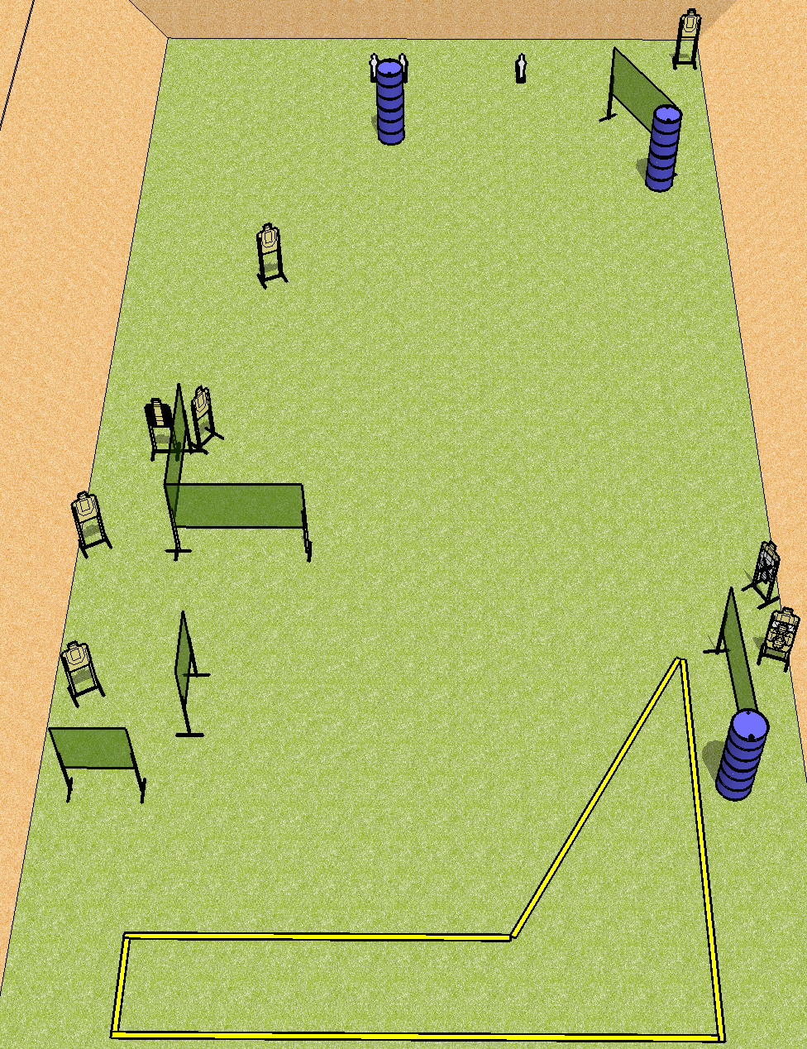
 | Dothan Practical Shooters – USPSA Match A Long Way Course Designer : Drew Coleman Bay: A1
Round Count 21 rounds 9 USPSA 3 mini poppers
Equipment List 11 wall feet Back fault line is 30’ wide 1 tux 10 targets (8 + 2NS)

Slide 6
A Long Way
Written Stage Briefing
Scoring: Comstock Rounds: 21
Targets: 9 USPSA, 3 steel
Handgun start position: anywhere inside the shooting area, wrists below belt. Handgun is loaded and holstered.
PCC start position: anywhere inside the shooting area, stock on belt. Loaded carbine is held with both hands, safety on.
Stage Procedure: on the audible start signal, engage targets as they become available from within the shooting area.

Slide 7
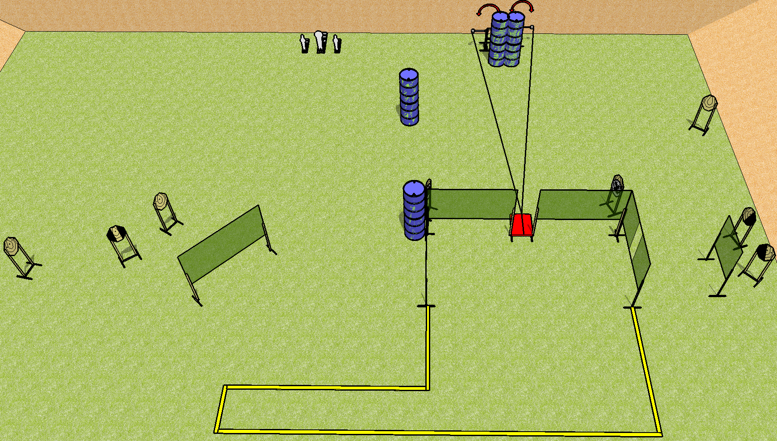
 | Dothan Practical Shooters – USPSA Match Tabletop Course Designer : Drew Coleman Bay: B2
Round Count 23 rounds 10 IPSC 2 mini, 1 colt
Equipment List 10 wall feet 1 tux, 1 left + 1 right diag 9 targets (7 + 2 NS)

Slide 8
Tabletop
Written Stage Briefing
Scoring: Comstock Rounds: 23
Targets: 10 IPSC, 3 steel
Start position: behind table, hands touching marks. Firearm is unloaded and unpropped, left or right of stomp pad. First magazine to be used is on opposite side of table.
Stage Procedure: on the audible start signal, engage targets as they become available from within the shooting area. The swingers are activated by the stomp pad and remain visible at rest.

Slide 9
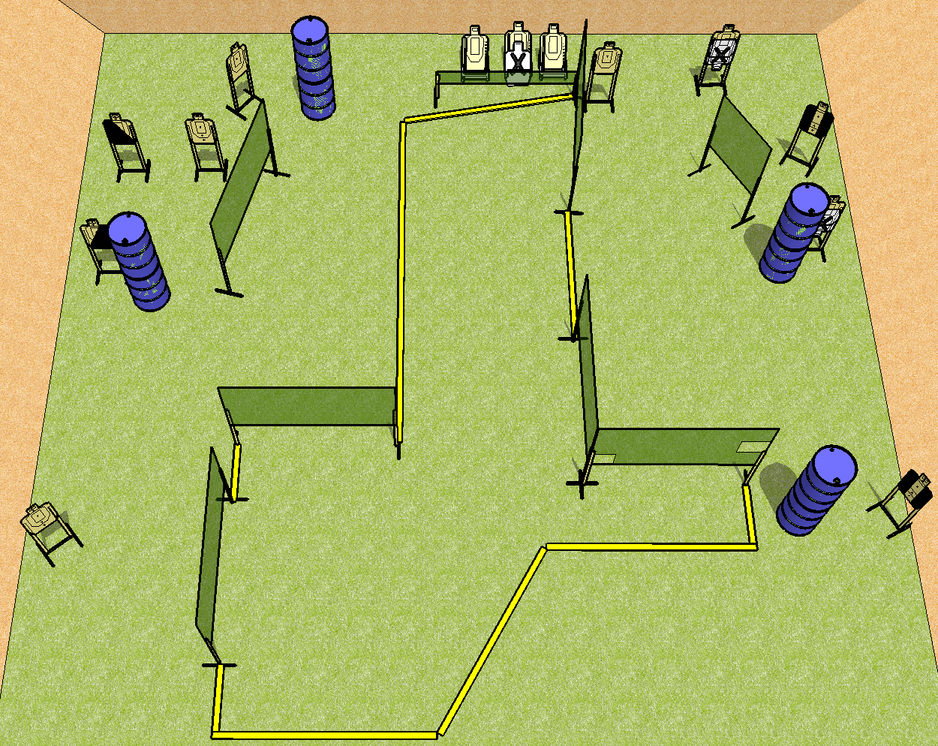
 | Dothan Practical Shooters – USPSA Match Cul-De-Sac Course Designer : Drew Coleman Bay: B1
Round Count 26 rounds 13 USPSA
Equipment List 14 wall feet Low wall 2 tux, 1 left + 1 right diag 12 targets (9 + 3 NS)

Slide 10
Cul-De-Sac
Written Stage Briefing
Scoring: Comstock Rounds: 26
Targets: 13 USPSA
Handgun start position: anywhere completely outside the shooting area, wrists below belt. Handgun is loaded and holstered.
PCC start position: anywhere completely outside the shooting area, stock on belt. Loaded carbine is held with both hands, safety on.
Stage Procedure: on the audible start signal, engage targets as they become available from within the shooting area.

Slide 11
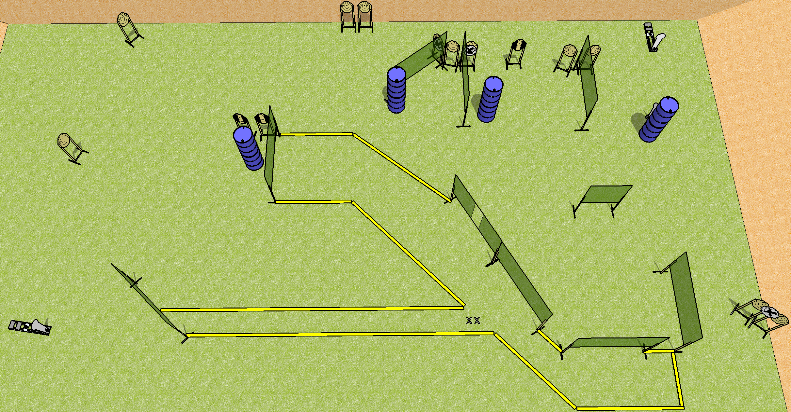
 | Dothan Practical Shooters – USPSA Match Big Bertha Course Designer : Drew Coleman Bay: A2
Round Count 31 rounds 14 IPSC 3 colt poppers
Equipment List 19 wall feet 3 tux 14 paper (11 + 3 NS)
8’ fault lines
30’
10’ fault lines

Slide 12
Big Bertha
Written Stage Briefing
Scoring: Comstock Rounds: 31
Targets: 14 IPSC, 3 steel
Handgun start position: feet on X’s, wrists below belt. Handgun is loaded and holstered.
PCC start position: feet on X’s, stock on belt. Loaded carbine is held with both hands, safety on.
Stage Procedure: on the audible start signal, engage targets as they become available from within the shooting area.

